Slide 1
Chapter Eleven
Frequency Domain Design
Wei Liu

Slide 2
Contents
11.1 Sensitivity Functions
11.2 Feedforward Design
11.3 Performance Specifications
11.4 Feedback Design via Loop Shaping
11.5 Fundamental Limitations
11.6 Design Example

Slide 3

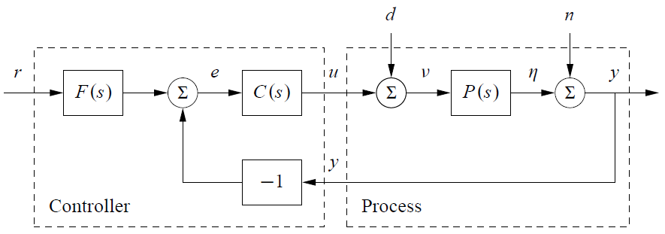

11.1 Sensitivity Functions
One of the key ideas in this chapter is that we can design the behavior of the closed loop system by focusing on the open loop transfer function.
loop transfer function is $L = PC$
the tracking response of the closed loop system

Slide 4
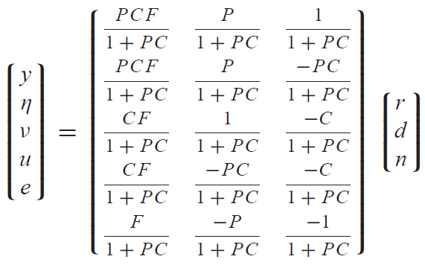
11.1 Sensitivity Functions
The feedback loop is influenced by three external signals, the reference $r$ , the load disturbance $d$ and the measurement noise $n$.

Slide 5

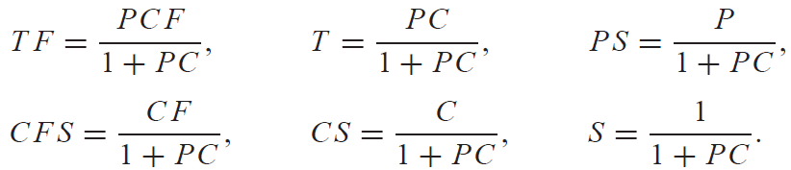
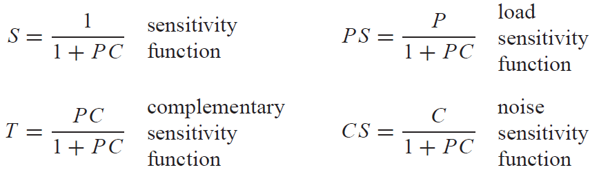
11.1 Sensitivity Functions
The transfer function for the error between the reference $r$ and the output $η$
we can observe that several transfer functions are the same and that the majority of the relations are given by the following set of six transfer functions, which we call the Gang of Six:
The special case when $F = 1$ is called a system with (pure) error feedback.
Gang of Four

Slide 6
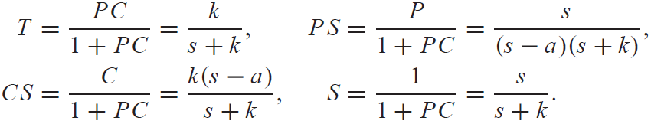
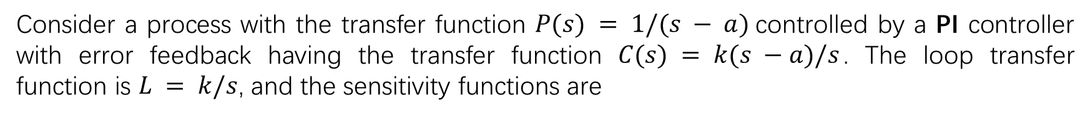
11.1 Sensitivity Functions
Example 11.1 The loop transfer function gives only limited insight
Consider a process with the transfer function $P(s) = 1/(s − a)$controlled by a PI controller with error feedback having the transfer function $C(s) = k(s −a)/s$. The loop transfer function is $L = k/s$, and the sensitivity functions are
Notice that the factor $s−a$ is canceled when computing the loop transfer function.

Slide 7
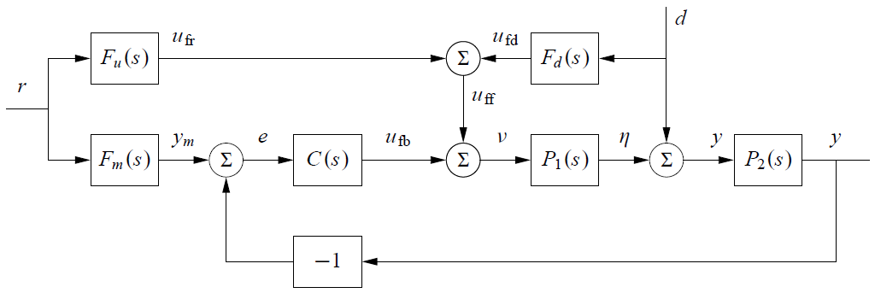


11.2 Feedforward Design
The transfer function from reference input to process output ($d=0$):
Perfect feedforward compensation is obtained by choosing

Slide 8


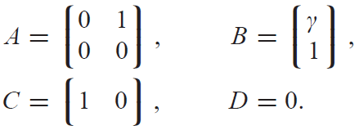



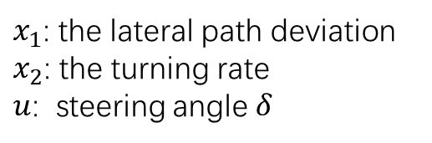

11.2 Feedforward Design
Assuming that the reference $r$ is zero, the transfer function from the disturbance to the process output is
Perfect compensation is obtained by choosing
Example 11.2 Vehicle steering
$x_{1}$: the lateral path deviation
$x_{2}$: the turning rate
$u$: steering angle $δ$
transfer function from steering angle $δ$ to lateral deviation $y$ is
choose the desired response as
is a stable transfer function as long as $γ>0$

Slide 9

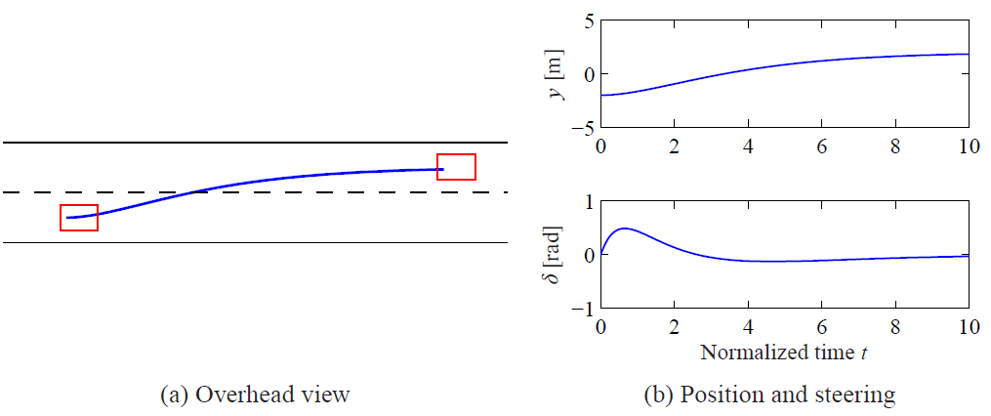

11.2 Feedforward Design
choose the desired response
$$a = 0.5.$$

Slide 10



11.3 Performance Specifications
A resonant peak is a maximum of the gain, and the peak frequency is the corresponding frequency. The gain crossover frequency is the frequency where the open loop gain is equal one. The bandwidth is defined as the frequency range where the closed loop gain is 1/√2 of the low-frequency gain (low-pass), mid-frequency gain (band-pass) or high-frequency gain (high-pass).
Response to Reference Signals
Response of the output
Response of the control
Notes:
Common features of frequency responses are resonant peak, peak frequency, gain crossover frequency and bandwidth. There are interesting relations between specifications in the time and frequency domains. Roughly speaking, the behavior of time responses for short times is related to the behavior of frequency responses at high frequencies, and vice versa.
Notice that it is useful to consider both the response of the output and that of the control signal. In particular, the control signal response allows us to judge the magnitude and rate of the control signal required to obtain the output response.

Slide 11


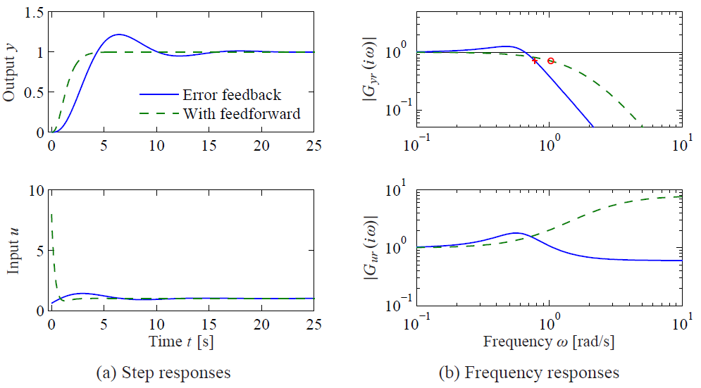
11.3 Performance Specifications
Example 11.3 Third-order system
a PI controller with error feedback having the gains $k_{p}=0.6$ and $k_{i}=0.5$.
a controller with feedforward designed to give the transfer function

Slide 12

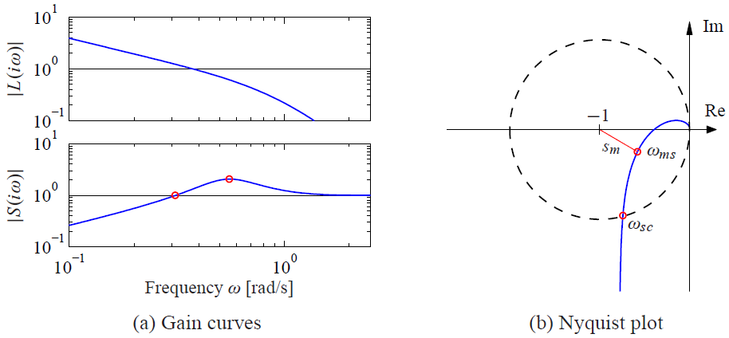




11.3 Performance Specifications
Response to Load Disturbances and Measurement Noise
The sensitivity function tells how the variations in the output are influenced by feedback.
Transfer function from load disturbance to process output
Transfer function from the measurement noise to the control signal

Slide 13

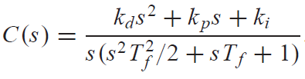
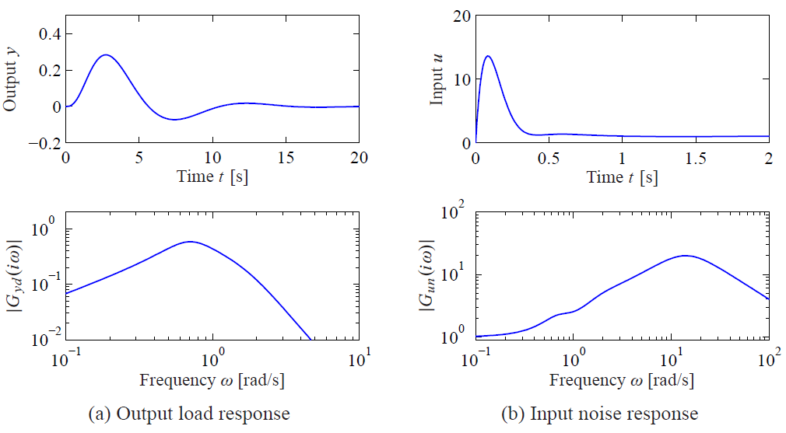
11.3 Performance Specifications
Example 11.4 Third-order system
augment the controller using a second-order noise filter with $T_{f}=0.1$

Slide 14
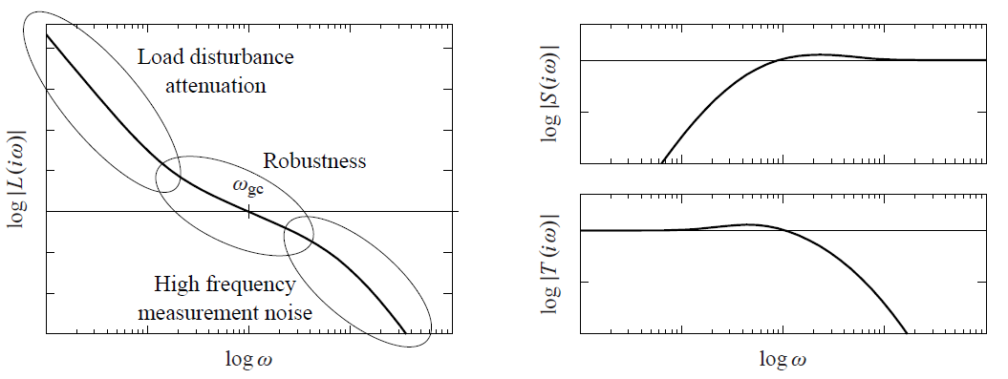

11.4 Feedback Design via Loop Shaping
Loop shaping methods are based on choosing a compensator that gives a loop transfer function with a desired shape.
Design Considerations

Slide 15

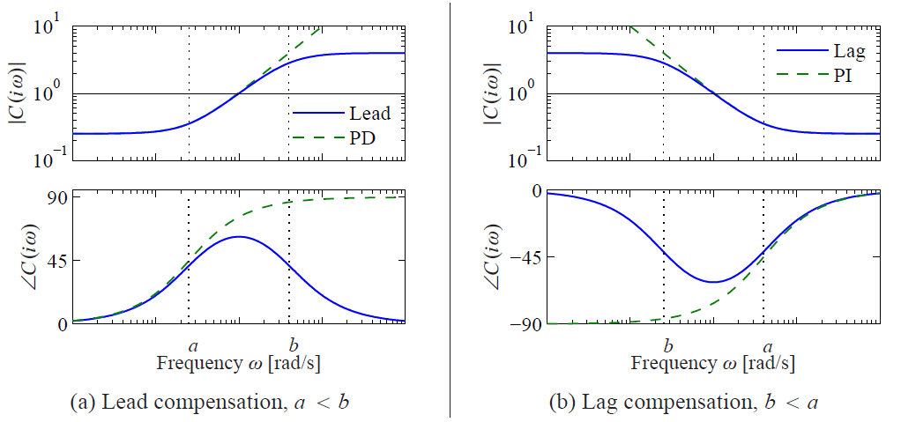
11.4 Feedback Design via Loop Shaping
Lead and Lag Compensation
A simple way to do loop shaping is to start with the transfer function of the process and add simple compensators with the transfer function
Lead compensator if a < b, PD controller a = 0.
Lag compensator if a > b, eg. PI controller: b = 0

Slide 16

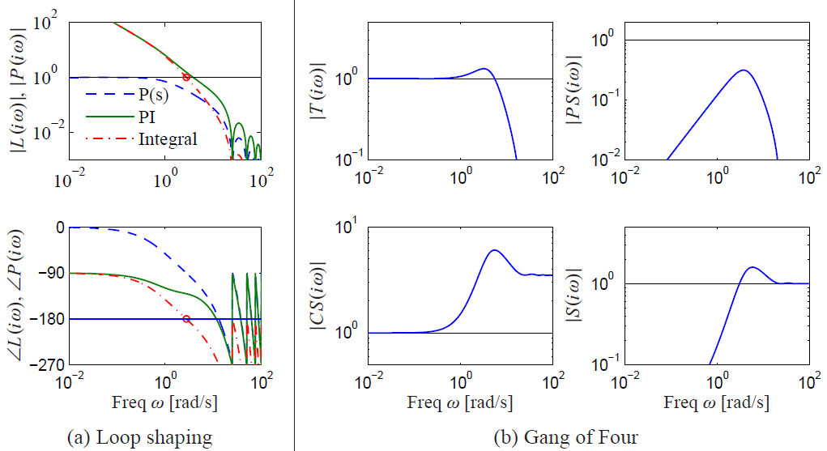
11.4 Feedback Design via Loop Shaping
Example 11.5 Atomic force microscope in tapping mode

Slide 17
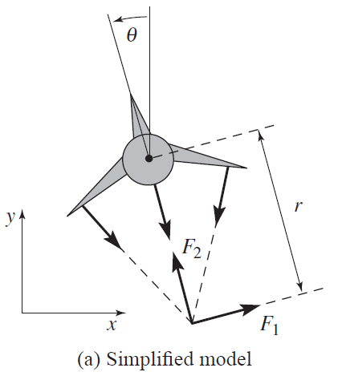

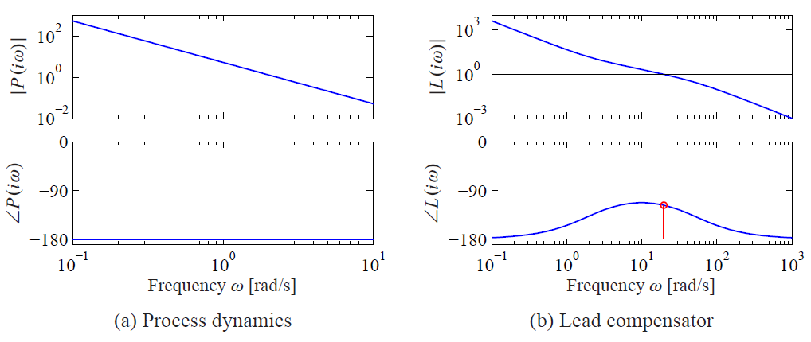
11.4 Feedback Design via Loop Shaping
Example 11.6 Roll control for a vectored thrust aircraft
performance specification: less than 1% error in steady state and less than 10% tracking error up to 10 rad/s.

Slide 18

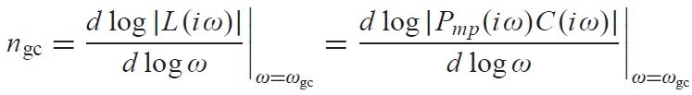



11.5 Fundamental Limitations
Although loop shaping gives us a great deal of flexibility in designing the closed loop response of a system, there are certain fundamental limits on what can be achieved. We consider here some of the primary performance limitations that can occur because of difficult dynamics.
Right Half-Plane Poles and Zeros and Time Delays
where $P_{mp}$ is the minimum phase part and $P_{ap}$ is the nonminimum phase part.
Requiring that the phase margin be $φ_{m}$
From Bode’s relations, equation (9.8),
gain crossover frequency inequality

Slide 19






11.5 Fundamental Limitations
Example 11.7 Zero in the right half-plane
The phase lag
According to gain crossover frequency inequality
Time delays also impose limitations similar to those given by zeros in the right half-plane.
A long time delay is thus equivalent to a slow right half-plane zero

Slide 20



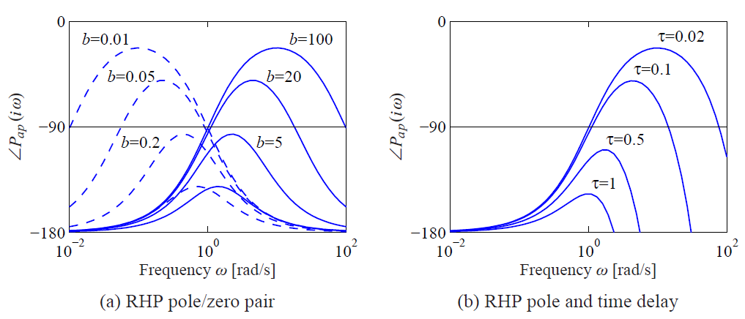
11.5 Fundamental Limitations
Example 11.8 Pole in the right half-plane
The phase lag of the nonminimum phase part is
According to the crossover frequency inequality

Slide 21
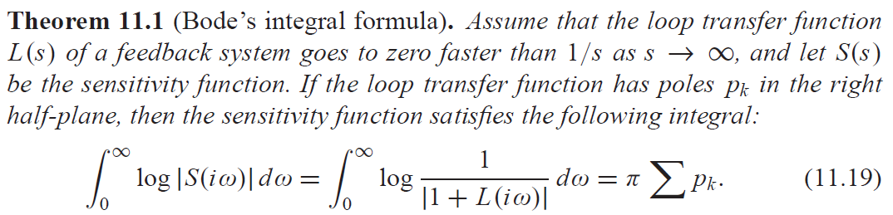
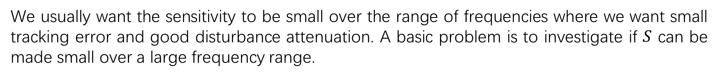
11.5 Fundamental Limitations
Bode’s Integral Formula
We usually want the sensitivity to be small over the range of frequencies where we want small tracking error and good disturbance attenuation. A basic problem is to investigate if $S$ can be made small over a large frequency range.
This means that if disturbance attenuation is improved in one frequency range, it will be worse in another, a property sometime referred to as the waterbed effect.

Slide 22

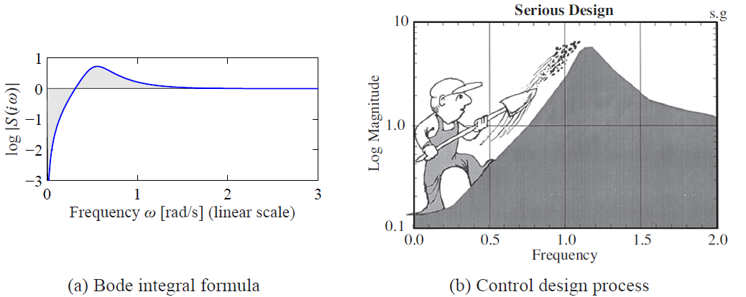

11.5 Fundamental Limitations
Bode’s Integral Formula
If the loop transfer function has no poles in the right half-plane, the equation simplifies to

Slide 23
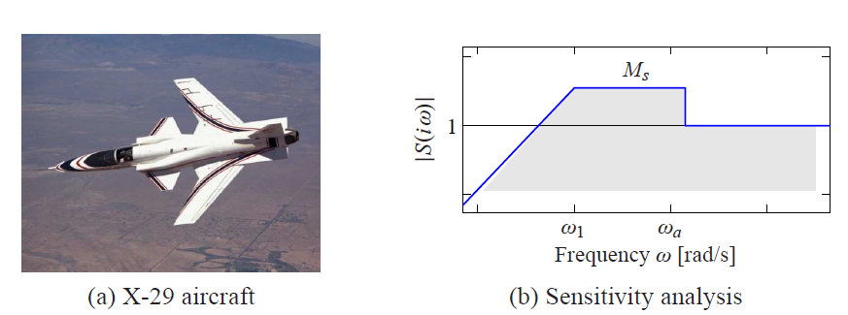
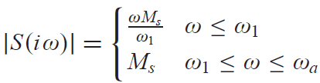
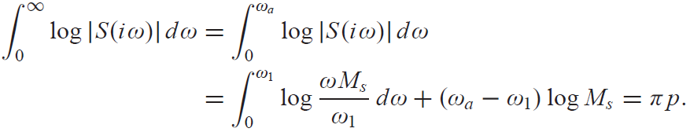

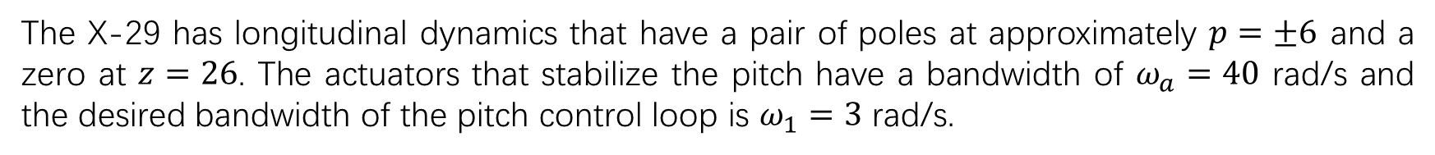
11.5 Fundamental Limitations
Example 11.11 X-29 aircraft
The X-29 has longitudinal dynamics that have a pair of poles at approximately $p=±6$ and a zero at $z=26$. The actuators that stabilize the pitch have a bandwidth of $ω_{a}=40$ rad/s and the desired bandwidth of the pitch control loop is $ω_{1}=3$ rad/s.

Slide 24
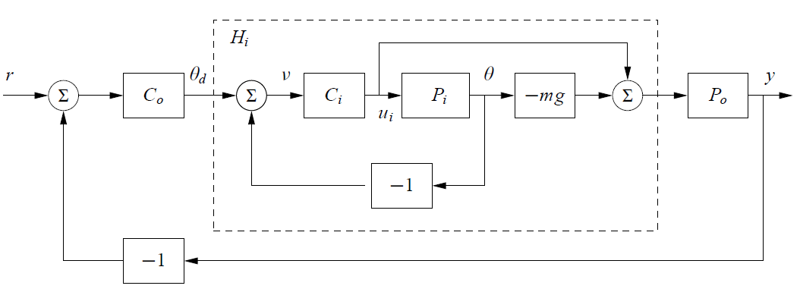


11.6 Design Example
Example 11.12 Lateral control of a vectored thrust aircraft
desired bandwidth to be 10 rad/s (10 times that of the outer loop) and the low-frequency error to be no more than 5%.

Slide 25

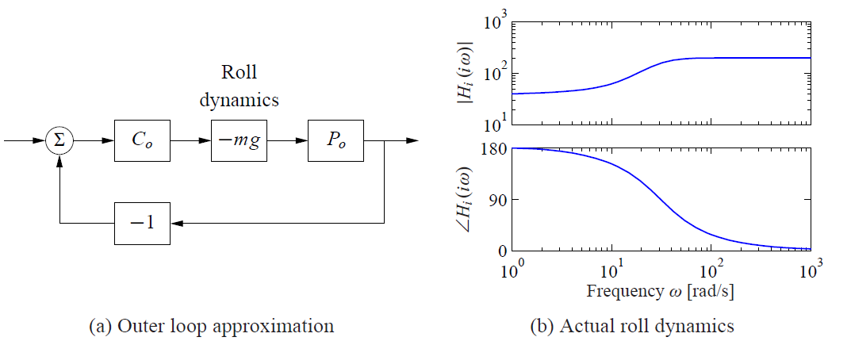



11.6 Design Example
Example 11.12 Lateral control of a vectored thrust aircraft

Slide 26
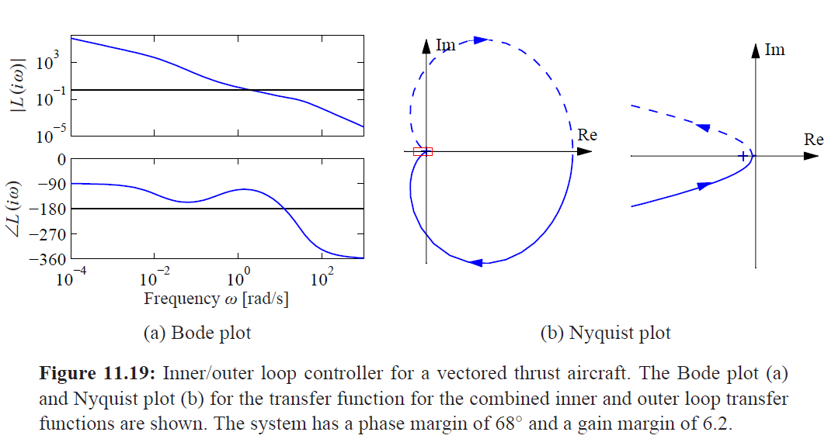
11.6 Design Example
Example 11.12 Lateral control of a vectored thrust aircraft

Slide 27
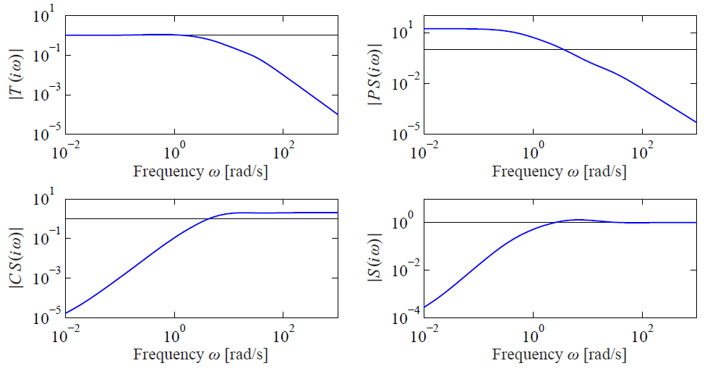
11.6 Design Example
Example 11.12 Lateral control of a vectored thrust aircraft

